Slide 1
HEALTHY AND UNHEALTHY ITEMS
BY-ADVITYA BHATIA

Slide 2
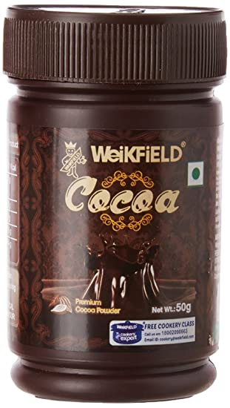
COCOA POWDER
NET WEIGHT:50 GRAMS
RATE:60 RUPEES

Slide 3
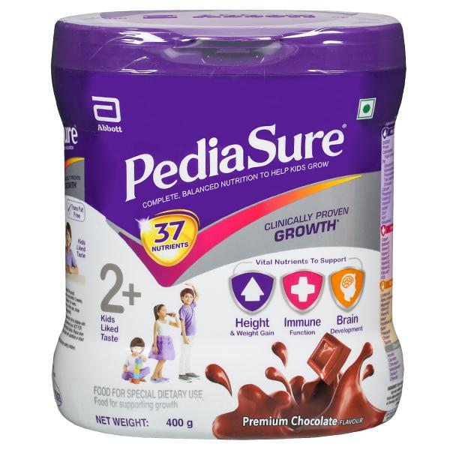
PEDIA SURE
NET WEIGHT:400 GRAMS
RATE:550 RUPEES

Slide 4
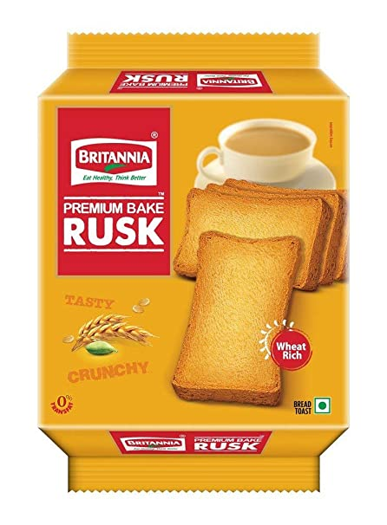
BRITANNIA RUSK
NET WEIGHT:200 GRAMS
RATE:30 RUPEES

Slide 5
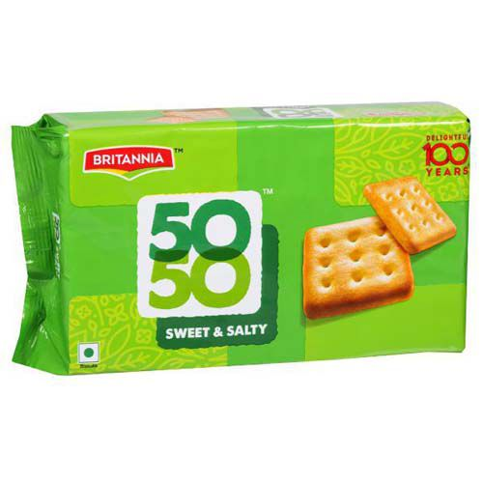
BRITANNIA BUISCUITS
NET WEIGHT:200 GRAMS
RATE:20 RUPEES

Slide 6
COCA COLA
NET WEIGHT:500 ML
RATE:30 RUPEES

Slide 7
HEALTHIEST
PEDIA SURE IS HEALTHY BECAUSE
IT IS A GOOD SOURCE OF NURITION FOR CHILDREN
IT HAS 37 NUTRIENTS
IT HELPS IN HEIGHT AND WEIGHT GAIN BECAUSE OF PROTEINS, CALCIUM, VITAMIN D , IRON , IODINE
IT ALSO SUPPORTS IMMUNITY WITH ZINC, SELENIUM, COPPER, VITAMIN A, VITAMIN C , VITAMIN E
SUPPORTS BRAIN DEVELOPMENT WITH MAGNESIUM , BIOTINE , TAURINE , CHOLINE

Slide 8
UNHEALTHIEST
UNHEALTHIEST:COCA COLA
THE BAD EFFECTS OF COCA COLA ARE:
OBESITY
DIABETES
TOOTH DECAY
MOOD PROBLEMS
HEADACHES

